Slide 1
Android Widgets
Shou-Chih Lo
National dong hwa university
2021

Slide 2
Outline
Toolbar (Options Menu)
Show pop-up messages (Toast/AlertDialog/Snackbar)
Different kinds of buttons (CheckBox/RadioButton)
Show a list of data (Spinner/RecyclerView/ViewPager2)
Picture pickup

Slide 3
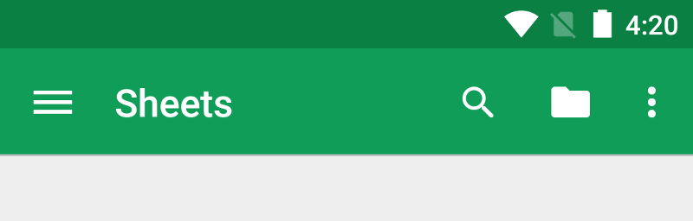
App bar/Toolbar
The app bar (or action bar) provides visual structure, standardized visual elements, and navigation
Suggest using toolbar instead of app bar
Nav drawer button
App name
Action button
Options-menu overflow button

Slide 4
Options Menu
Create the menu resource to provide menu items
Create the options menu by overriding the onCreateOptionsMenu()
Item selection events are handled by overriding the onOptionsItemSelected()

Slide 5
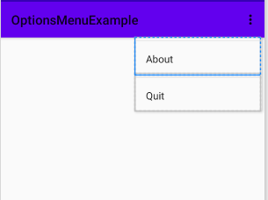
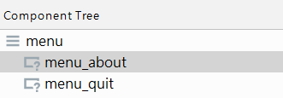
Menu Resource
<menu xmlns:app="http://schemas.android.com/apk/res-auto" xmlns:android="http://schemas.android.com/apk/res/android"> <item android:id="@+id/menu_about" android:title="About" /> <item android:id="@+id/menu_quit" android:title="Quit" /> </menu>

Slide 6
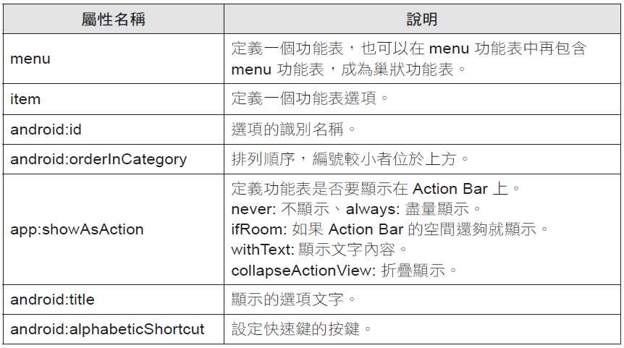
Menu Resource
android:icon for setting an icon image

Slide 7
Overriding Methods
override fun onCreateOptionsMenu(menu: Menu?): Boolean { menuInflater.inflate(R.menu.menu,menu) return super.onCreateOptionsMenu(menu) //or return true } override fun onOptionsItemSelected(item: MenuItem): Boolean { when (item.itemId) { R.id.menu_about -> Toast.makeText(this, "Options Menu Demo", Toast.LENGTH_SHORT).show() R.id.menu_quit -> finish() } return super.onOptionsItemSelected(item) //or return true }

Slide 8
Options Menu in Fragment
Suppose we have use the navigation architecture component (NavHostFragment)
Load another fragment when an options item is selected
Add the loaded fragment in the navigation graph, set the id to be the same as the menu item id
In the first loaded fragment, onCreateView()
setHasOptionsMenu(true)

Slide 9
Options Menu in Fragment
override fun onCreateOptionsMenu(menu: Menu, inflater: MenuInflater) { super.onCreateOptionsMenu(menu, inflater) inflater.inflate(R.menu.options_menu, menu) }
override fun onOptionsItemSelected(item: MenuItem): Boolean { return NavigationUI. onNavDestinationSelected(item,requireView().findNavController()) || super.onOptionsItemSelected(item) }

Slide 10
Toast
Pop over a view containing a quick little message for the user
val text = "Hello toast!" val duration = Toast.LENGTH_SHORT val toast = Toast.makeText(applicationContext, text, duration) toast.show()
(or) Use “this”, in an activity
Use “context”, if in a fragment
Or, using chaining method calls
Toast.makeText(applicationContext, text, duration).show()
Notes:
applicationContext: getApplicationContext //used in the activity only
context: getContext //the context this fragment is currently associated with

Slide 11
Toast
setGravity: change the position
Example
Toast.makeText(applicationContext, text, duration).apply {
setGravity(Gravity.CENTER, 0, 0)
show()
}
Apply codes on the same object

Slide 12
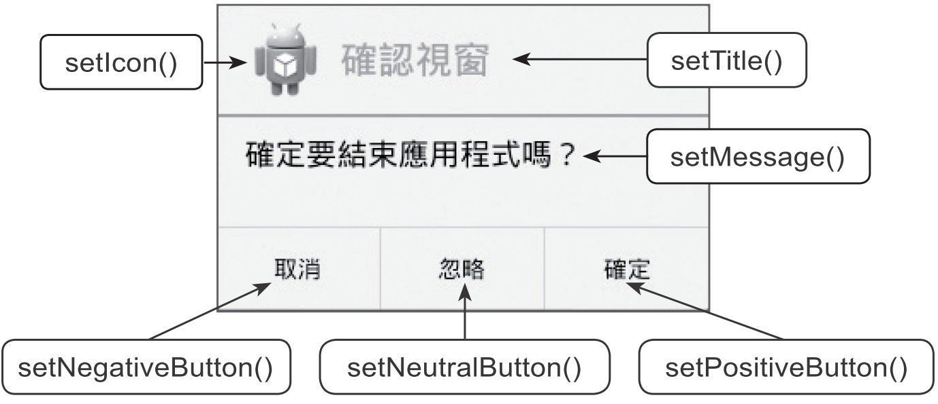
AlertDialog
A subclass of Dialog that can display one, two or three buttons

Slide 13
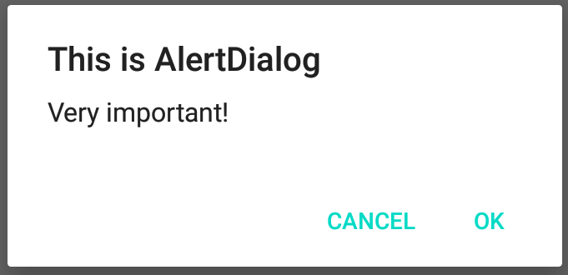
AlterDialog Example
private fun showAlertDialog(view: View) { AlertDialog.Builder(this).apply { setTitle("This is AlertDialog") setMessage("Very important!") setCancelable(false) setPositiveButton("OK") { dialog, which -> } setNegativeButton("CANCEL") { dialog, which -> } show() } }

Slide 14
Snackbar
Snackbars provide brief messages at the bottom of the screen
Can add interactive buttons
private fun showSnackbar(view: View) { Snackbar.make(view, "This is a snackbar messsage", Snackbar.LENGTH_SHORT)
.setAction(“Done”) { //omitted if not necessary
//action codes
}
.show() }
Notes:
View: any view on the layout or layout itself that the snackbar will be presented

Slide 15
CheckBox and RadioButton
CheckBox
two-states button that can be either checked or unchecked
RadioButton
similar to CheckBox but cannot be unchecked by the user once checked
normally used together in a RadioGroup (checking one radio button unchecks all the others)

Slide 16
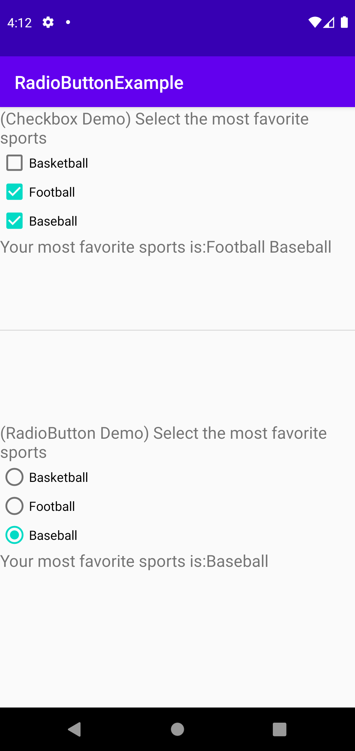
CheckBox and RadioButton
activity_main.xml includes two layouts
checkbox_layout.xml (id: checkbox_part)
radiobutton_layout.xml (id: radiobutton_part)

Slide 17
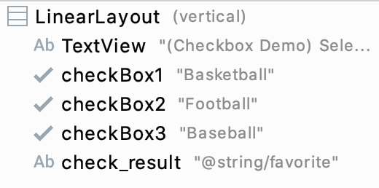
CheckBox Example
checkbox_layout.xml

Slide 18
CheckBox Example
//deal with checkboxs with (binding.checkboxPart) { checkBox1.setOnClickListener { myListener() } checkBox2.setOnClickListener { myListener() } checkBox3.setOnClickListener { myListener() } }
Notes:
Using view binding

Slide 19
CheckBox Example
private fun myListener() { var selected: String = "" with (binding.checkboxPart) { if (checkBox1.isChecked) selected += checkBox1.text.toString() + " " if (checkBox2.isChecked) selected += checkBox2.text.toString() + " " if (checkBox3.isChecked) selected += checkBox3.text.toString() + " " val final = getString(R.string.favorite) + selected checkResult.text = final } }

Slide 20
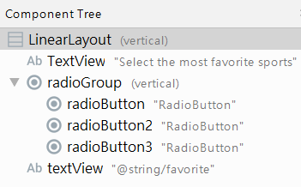
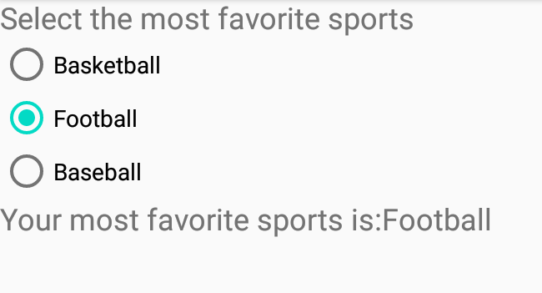
RadioButton Example

Slide 21
RadioButton Example
//deal with radio buttons with (binding.radiobuttonPart) { radioGroup.setOnCheckedChangeListener { group, checkedId -> val selected = findViewById<RadioButton>(checkedId).text.toString() val final = getString(R.string.favorite) + selected radioResult.text = final } }

Slide 22
Spinner
Provide a quick way to select one value from a set through a dropdown menu
Steps
Provide a data source to the Spinner through an Adapter
The adapter deals with the data binding and the view presentation
Specify the kind of the spinner layout
Implement the OnItemSelectedListener interface

Slide 23
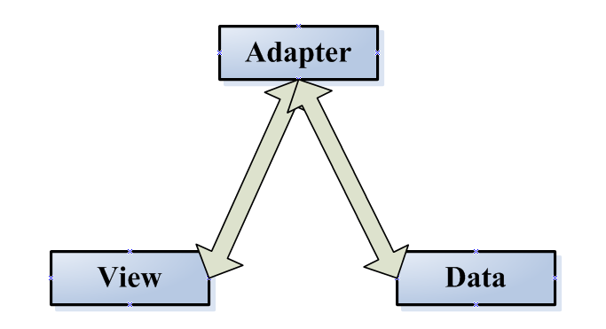
Working Model
ArrayAdapter
Position may be not equal to row Id, if AdapterView contains a header
AdapterView
Array (data source)
0
1
2
3
View
0 Item
1 Item
2 Item
3 Item
View
View
View
Position
row Id (or Primary Key)

Slide 24
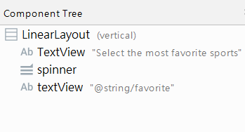
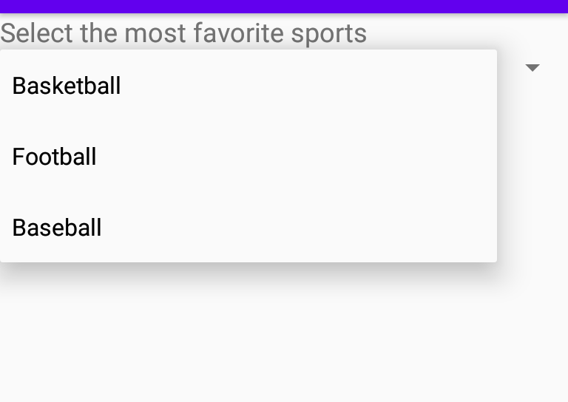
Spinner Example
<string name="favorite">Your most favorite sports is: %s</string>
<string-array name="balls"> <item>Basketball</item> <item>Football</item> <item>Baseball</item> </string-array>
Provide data source from the resource file

Slide 25
private val balls = listOf("Basketball", "Football", "Baseball")
val adapter = ArrayAdapter<String>(this, android.R.layout.simple_spinner_item, balls) // val adapter = ArrayAdapter.createFromResource(this, R.array.balls, android.R.layout.simple_spinner_item)
adapter.setDropDownViewResource(android.R.layout.simple_spinner_dropdown_item) binding.spinner.adapter = adapter binding.spinner.onItemSelectedListener = object : AdapterView.OnItemSelectedListener { override fun onItemSelected(parent: AdapterView<*>?, view: View?, position: Int, id: Long)
{ val selected = parent?.getItemAtPosition(position).toString() binding.textView.text = getString(R.string.favorite, selected) } override fun onNothingSelected(parent: AdapterView<*>?) {}
Notes:
android.R.layout.simple_spinner_dropdown_item //item name with a radio button??

Slide 26
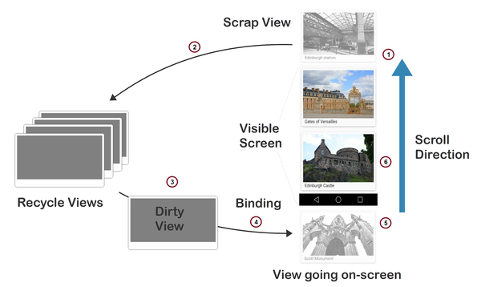
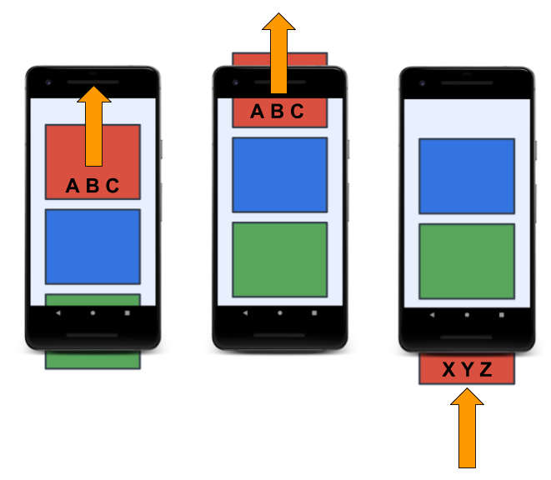
RecyclerView
A more advanced and flexible version of ListView
Only does work to process or draw items that are currently visible on the screen

Slide 27
Summary
RecyclerView uses an adapter to transform app data into something it can display
To display your data in a RecyclerView, you need the following parts:
LayoutManager (LinearLayoutManager, GridLayoutManager)
Layout for each item
Adapter (impement getItemCount(), onCreateViewHolder(), onBindViewHolder()
ViewHolder (contains the reference to each UI views for one item)

Slide 28
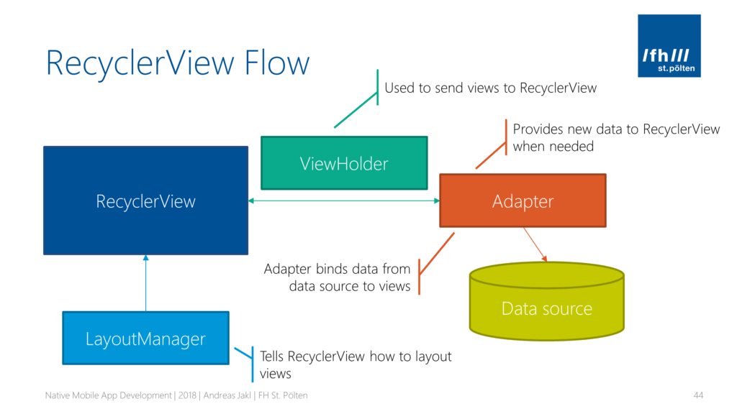
RecyclerView Working Model
Notes:
RecyclerView recycles ViewHolders that move offscreen and populates them with new data, ready to be shown at the bottom of the list.

Slide 29
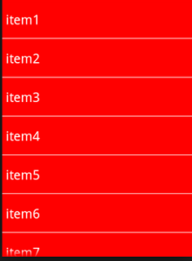
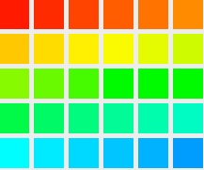
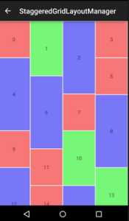
LayoutManager
Handles the organization (the layout) of UI components in a view
Three kinds: LinearLayoutManager, GridLayoutmanager, StaggeredGridLayoutManager

Slide 30
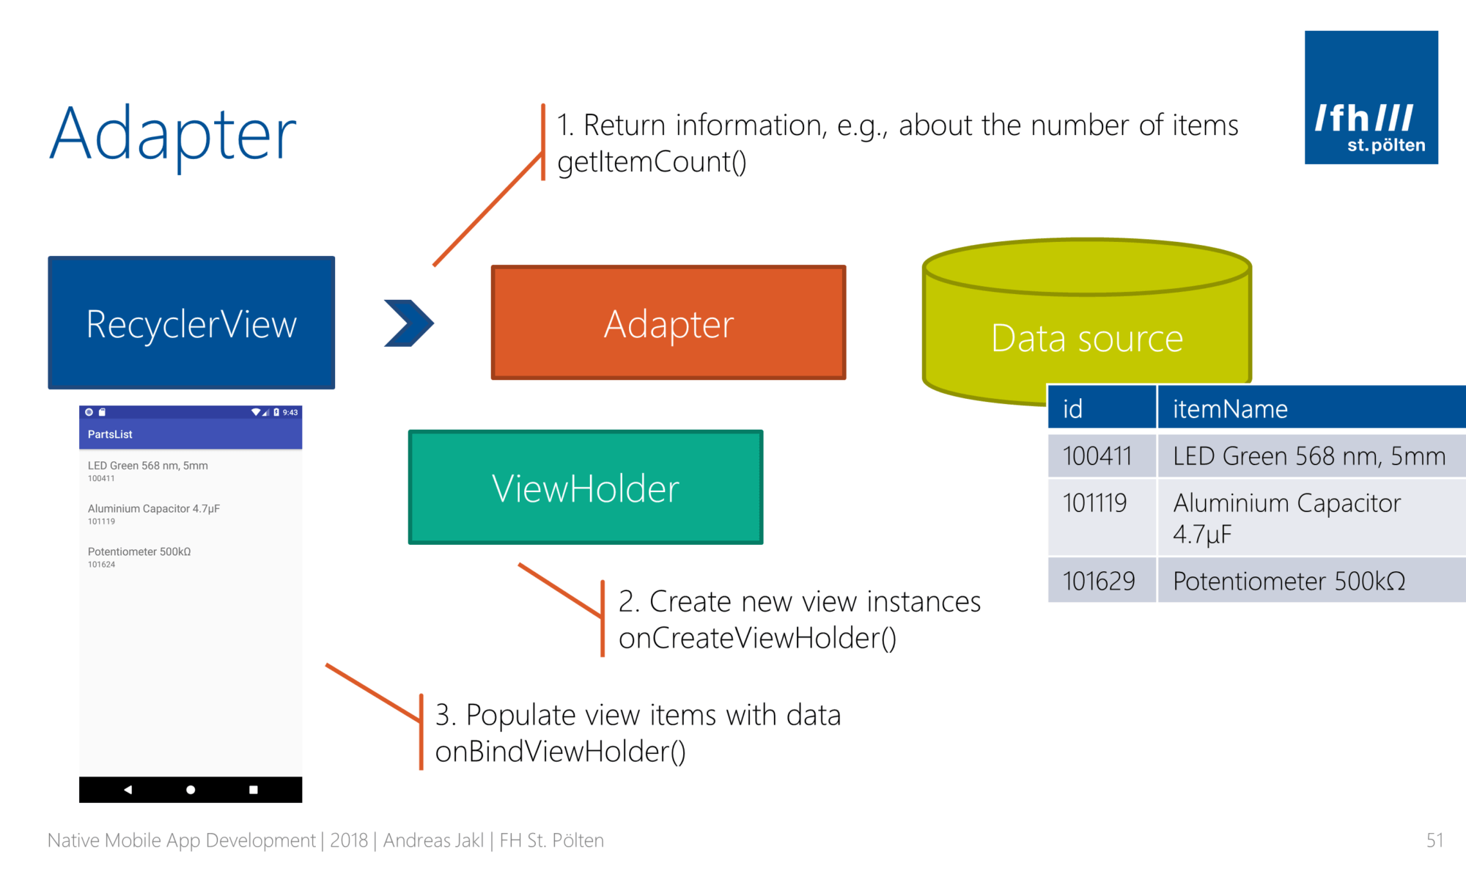
RecyclerView Adapter

Slide 31
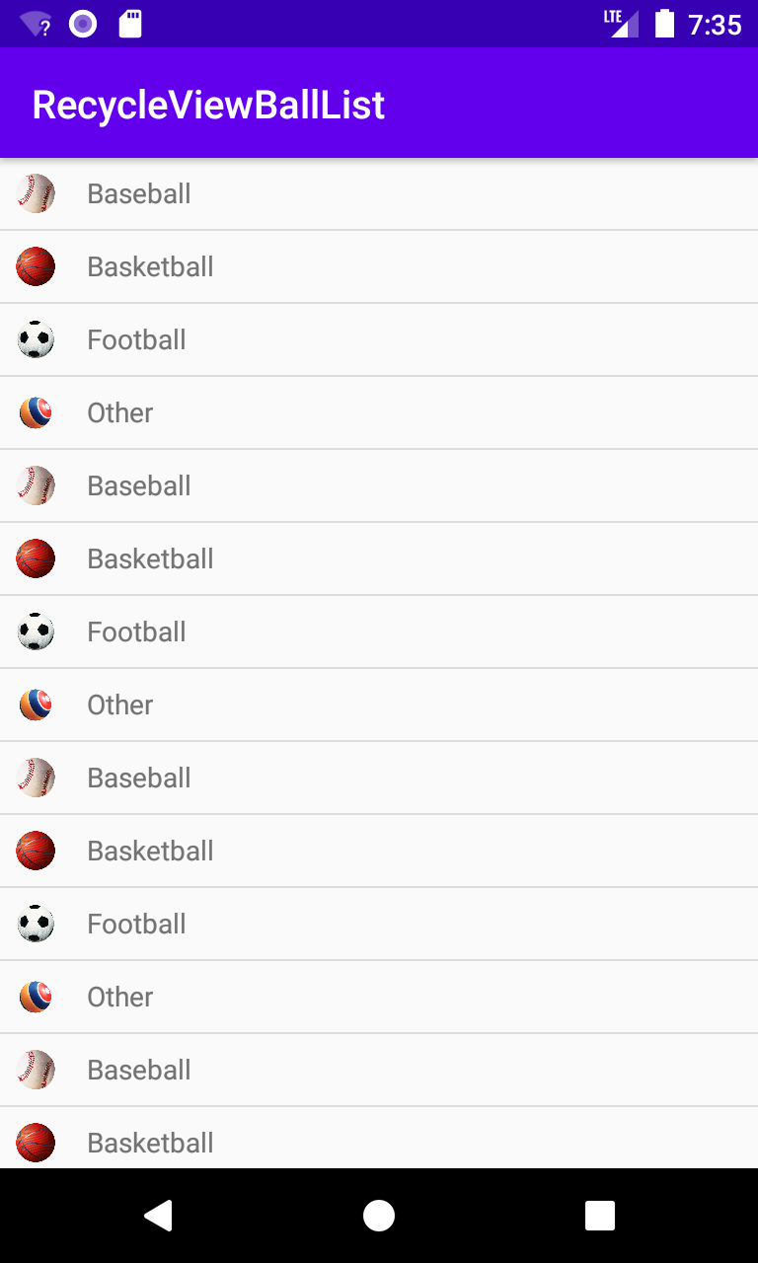
RecyclerView Example
Data source
data class Balls(val name: String, val imageId: Int)
private val ballList = ArrayList<Balls>()
private fun initBallList() {
repeat(6) {
ballList.add(Balls("Baseball",R.drawable.baseball))
ballList.add(Balls("Basketball",R.drawable.basketball))
ballList.add(Balls("Football",R.drawable.football))
ballList.add(Balls("Other",R.drawable.other))
}
}
Notes:
//add dependency automatically
implementation 'androidx.recyclerview:recyclerview:1.2.0'

Slide 32
RecyclerView Setting
val layoutManager = LinearLayoutManager(this) binding.recycleView.layoutManager = layoutManager val adapter = BallAdapter(ballList) //pass by reference binding.recycleView.adapter = adapter binding.recycleView.addItemDecoration(DividerItemDecoration(this, DividerItemDecoration.VERTICAL)) //add a divider line

Slide 33
RecyclerView Adapter
class BallAdapter(val ballList: List<Balls>): Adapter<BallAdapter.ViewHolder>() { inner class ViewHolder(view: View): RecyclerView.ViewHolder(view) { val ballImage: ImageView = view.findViewById(R.id.imageView) val ballName: TextView = view.findViewById(R.id.textView) } override fun onCreateViewHolder(parent: ViewGroup, viewType: Int): ViewHolder { val view = LayoutInflater.from(parent.context).inflate(R.layout.my_layout, parent, false) val viewHolder = ViewHolder(view) viewHolder.itemView.setOnClickListener { //onClick Toast.makeText(parent.context, ballList[viewHolder.bindingAdapterPosition].name,
Toast.LENGTH_SHORT).show() } return viewHolder }
adapterPosition (if not working)
Notes:
itemView: view item that is held by the viewHolder
adapterPosition is deprecated after 1.2.0

Slide 34
RecyclerView Adapter
//populate data items on the view
override fun onBindViewHolder(holder: ViewHolder, position: Int) { val ball = ballList[position] //position at the data set holder.ballImage.setImageResource(ball.imageId) holder.ballName.text = ball.name }
//get the number of total items
override fun getItemCount(): Int { return ballList.size } }

Slide 35
Using GridLayoutManager
Number of spans (columns)
MainActivity
Adapter
(New) my_layout_vertical.xml
Change the orientation of the LinearLayout to be vertical
val layoutManager = GridLayoutManager(this, 2, GridLayoutManager.VERTICAL, false)
override fun onCreateViewHolder(parent: ViewGroup, viewType: Int): ViewHolder { val view =
LayoutInflater.from(parent.context).inflate(R.layout.my_layout_vertical, parent, false)

Slide 36
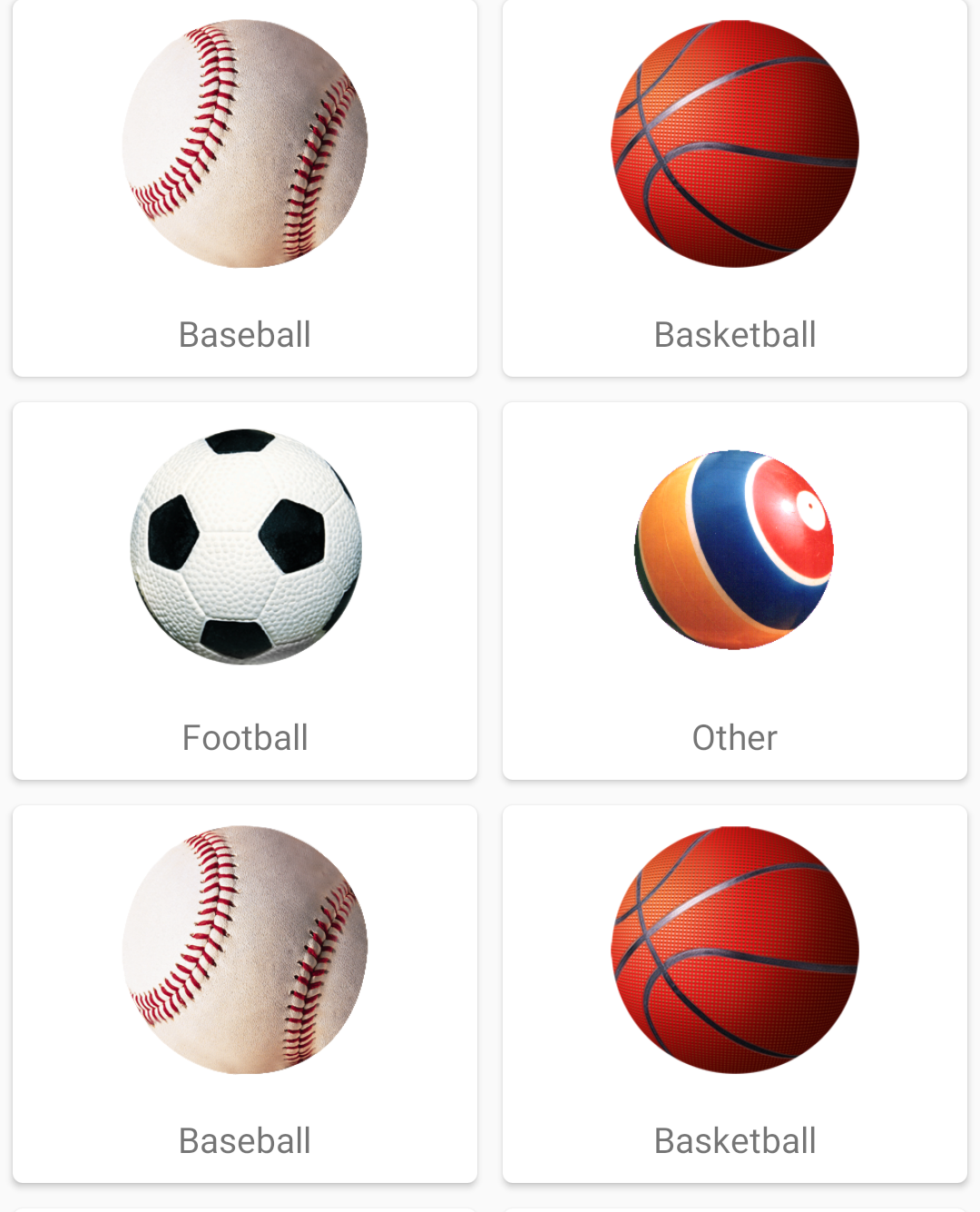
Using CardView
<androidx.cardview.widget.CardView
android:layout_width="match_parent" android:layout_height="wrap_content" android:layout_margin="5dp" app:cardCornerRadius="4dp"> <LinearLayout …> <ImageView … /> <TextView … /> </LinearLayout> </androidx.cardview.widget.CardView>

Slide 37
Using Data Binding
<layout … >
<data>
<variable
name="ball"
type="com.example.recycleviewballlist.Balls" />
</data>
<LinearLayout …>
<ImageView
…
android:imageResource="@{ball.imageId}"
<TextView
…
android:text="@{ball.name}" />
</LinearLayout>
</layout>
Notes:
Default setter: setImageResource()

Slide 38
Using Data Binding
class BallAdapter(val ballList: List<Balls>): Adapter<BallAdapter.ViewHolder>() { inner class ViewHolder(val binding: MyLayoutBinding):
RecyclerView.ViewHolder(binding.root) { } override fun onCreateViewHolder(parent: ViewGroup, viewType: Int): ViewHolder { val layoutInflater = LayoutInflater.from(parent.context) val binding = MyLayoutBinding.inflate(layoutInflater, parent, false) val viewHolder = ViewHolder(binding) // set click listener
return viewHolder }
Notes:
Viewholder holds the binding to the view
Inner class can access the members of its outer class (not necessary in the project)

Slide 39
Using Data Binding
override fun onBindViewHolder(holder: ViewHolder, position: Int) { val ball = ballList[position] holder.binding.ball = ball holder.binding.executePendingBindings() }
Notes:
Update any views that have bind expressions

Slide 40
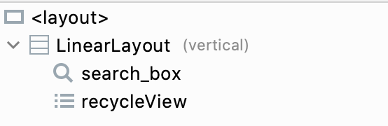
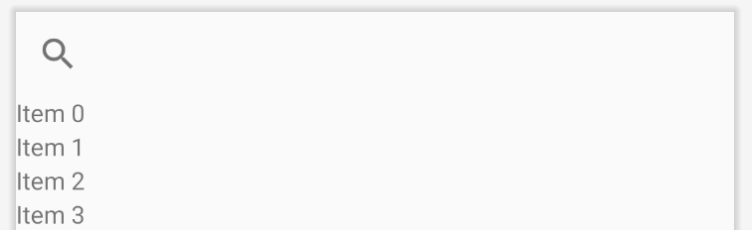
Combine SearchView
Provide a search box to filter the data

Slide 41
Setup SearchView
//configure the searchview binding.searchBox.setOnQueryTextListener(object: SearchView.OnQueryTextListener { override fun onQueryTextSubmit(query: String?): Boolean { return false } override fun onQueryTextChange(newText: String?): Boolean { adapter.filter.filter(newText) return true } })

Slide 42
Filter the Data
BallAdapter should inherit the Filterable interface and implement the following method
override fun getFilter(): Filter { return object: Filter() { override fun performFiltering(constraint: CharSequence?): FilterResults { //get the filtered result
} override fun publishResults(constraint: CharSequence?, results: FilterResults?) { filterList = results?.values as ArrayList<Balls> //inform the recyclerview to refresh the data notifyDataSetChanged() } }

Slide 43
override fun performFiltering(constraint: CharSequence?): FilterResults { val searchKey = constraint.toString() if (searchKey.isEmpty()) { filterList = ballList as ArrayList<Balls> } else { val resultList = ArrayList<Balls>() //temporary array ballList.forEach { if (it.name.toLowerCase().contains(searchKey.toLowerCase())) { resultList.add(it) } } filterList = resultList } val filterResults = FilterResults() filterResults.values = filterList return filterResults }

Slide 44
Using ListAdapter
It is RecyclerView.Adapter base class for presenting List data in a RecyclerView, including computing diffs between Lists on a background thread
Suitable for a large set of data items with data changes

Slide 45
Using ListAdapter
class BallAdapter: ListAdapter<Balls, BallAdapter.ViewHolder>(BallDiffCallback()) { inner class ViewHolder(val binding: MyLayoutBinding): RecyclerView.ViewHolder(binding.root) { } override fun onCreateViewHolder(parent: ViewGroup, viewType: Int): ViewHolder { //same as the example using data binding
//use getItem(viewHolder.bindingAdapterPosition)
} }

Slide 46
Using ListAdapter
//getItemCount() is not needed
override fun onBindViewHolder(holder: ViewHolder, position: Int) { //use the getItem to retrieve the data item
val ball = getItem(position) holder.binding.ball = ball holder.binding.executePendingBindings()
}

Slide 47
Implement DiffCallback
//Within class BallAdapter
class BallDiffCallback : DiffUtil.ItemCallback<Balls>() {
override fun areItemsTheSame(oldItem: Balls, newItem: Balls): Boolean { return oldItem == newItem //having the same id typically }
override fun areContentsTheSame(oldItem: Balls, newItem: Balls): Boolean { return oldItem == newItem } }

Slide 48
Combine ViewModel
class MyViewModel: ViewModel() { val ballList = MutableLiveData<List<Balls>>() //data source as LiveData init { val ballListSource = ArrayList<Balls>() //temporary array repeat(6) { with(ballListSource) { add(Balls("Baseball", R.drawable.baseball))
... } } ballList.value = ballListSource } }
Notes:
implementation 'androidx.lifecycle:lifecycle-viewmodel-ktx:2.3.1’
implementation 'androidx.lifecycle:lifecycle-livedata-ktx:2.3.1'

Slide 49
Combine ViewModel
Main Activity
val adapter = BallAdapter() //need not pass the data source initially
//observe any changes on the data source viewModel.ballList.observe(this, Observer { it?.let {
//submit the up-to-date ballList to the adapter adapter.submitList(it) } })

Slide 50
Use Binding Adapters
Provide a customized setter method to attributes that are bound to variables in an layout/xml file
<ImageView ...
app:ballImage="@{ball}" ...
/>
Customized app’s attribute
<TextView ...
app:Quality="@{ball}" ...
/>

Slide 51
Use Binding Adapters
@BindingAdapter("ballImage")
//function name can be arbitrary fun ImageView.setballImage(item: Balls?) { item?.let {
setImageResource(item.imageId)
} }
plugin “Kotlin-kapt”
@BindingAdapter(“quality”) fun TextView.setQuality(item: Balls?) {
item?.let { text = someConvertFunction(item) //example code
} }

Slide 52
ViewPager2
Display views or fragments to the user in a swipe-able format
A newer version of the ViewPager library and use a RecyclerView adapter
Often integrated with TabLayout which allows a user to switch pages through tabs

Slide 53
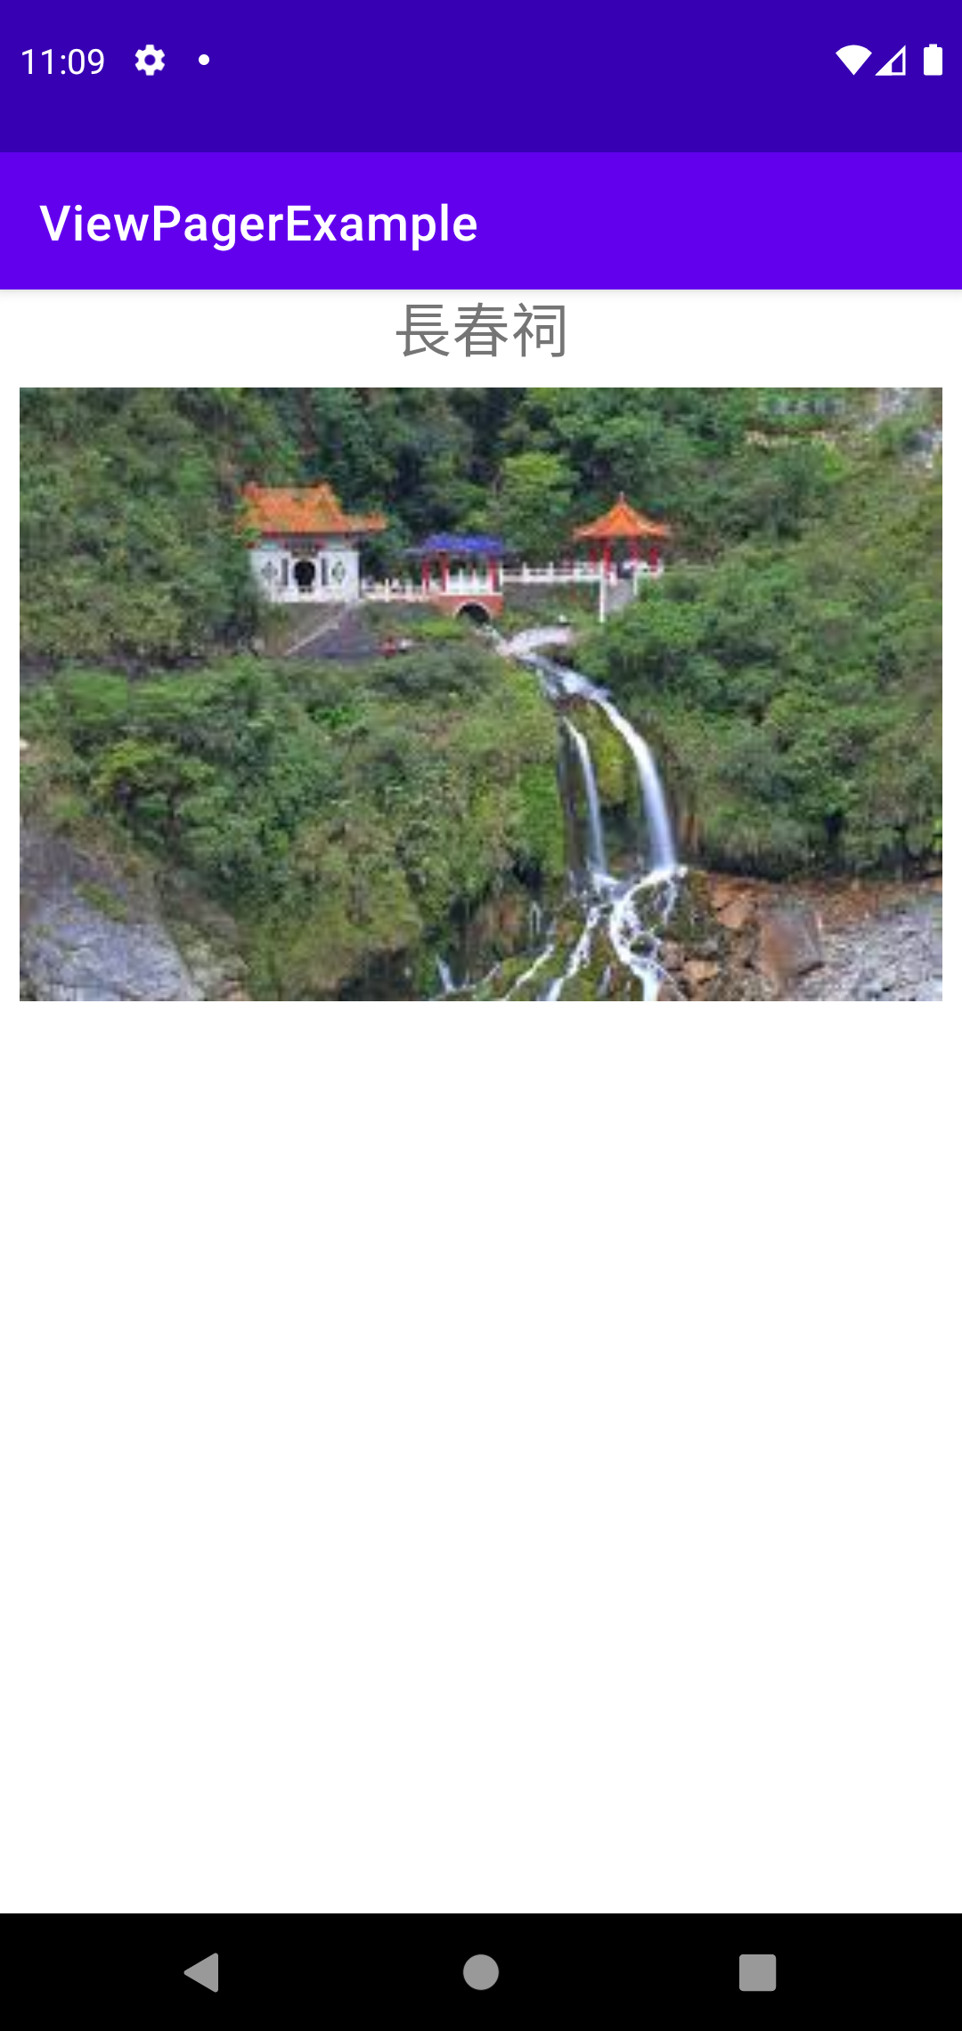
Swipe-able Views
activity_main.xml
Add one viewPager2
page_layout.xml (enable data binding)
One textView
One imageView
One binding variable photo
data class Photos(val location: String, val photoId: Int)

Slide 54
Implement RecyclerView Adapter
class PhotoAdapter(val photoList: List<Photos>): RecyclerView.Adapter<PhotoAdapter.ViewHolder>() { inner class ViewHolder(val binding: PageLayoutBinding): RecyclerView.ViewHolder(binding.root) { } override fun onCreateViewHolder(parent: ViewGroup, viewType: Int): ViewHolder { val layoutInflater = LayoutInflater.from(parent.context) val binding = PageLayoutBinding.inflate(layoutInflater, parent, false) val viewHolder = ViewHolder(binding) return viewHolder } override fun getItemCount(): Int { return photoList.size } override fun onBindViewHolder(holder: ViewHolder, position: Int) { val photo = photoList[position] holder.binding.photo = photo holder.binding.executePendingBindings() } }

Slide 55
Provide Data Source
private val photoList = ArrayList<Photos>()
private fun initPhotoList() { photoList.add(Photos("長春祠",R.drawable.photo1_0)) photoList.add(Photos("燕子口",R.drawable.photo1_1)) photoList.add(Photos("慈母橋",R.drawable.photo1_2)) }

Slide 56
Configure the ViewPager
val adapter = PhotoAdapter(photoList) binding.viewPager.adapter = adapter //binding.viewPager.orientation = ViewPager2.ORIENTATION_VERTICAL

Slide 57
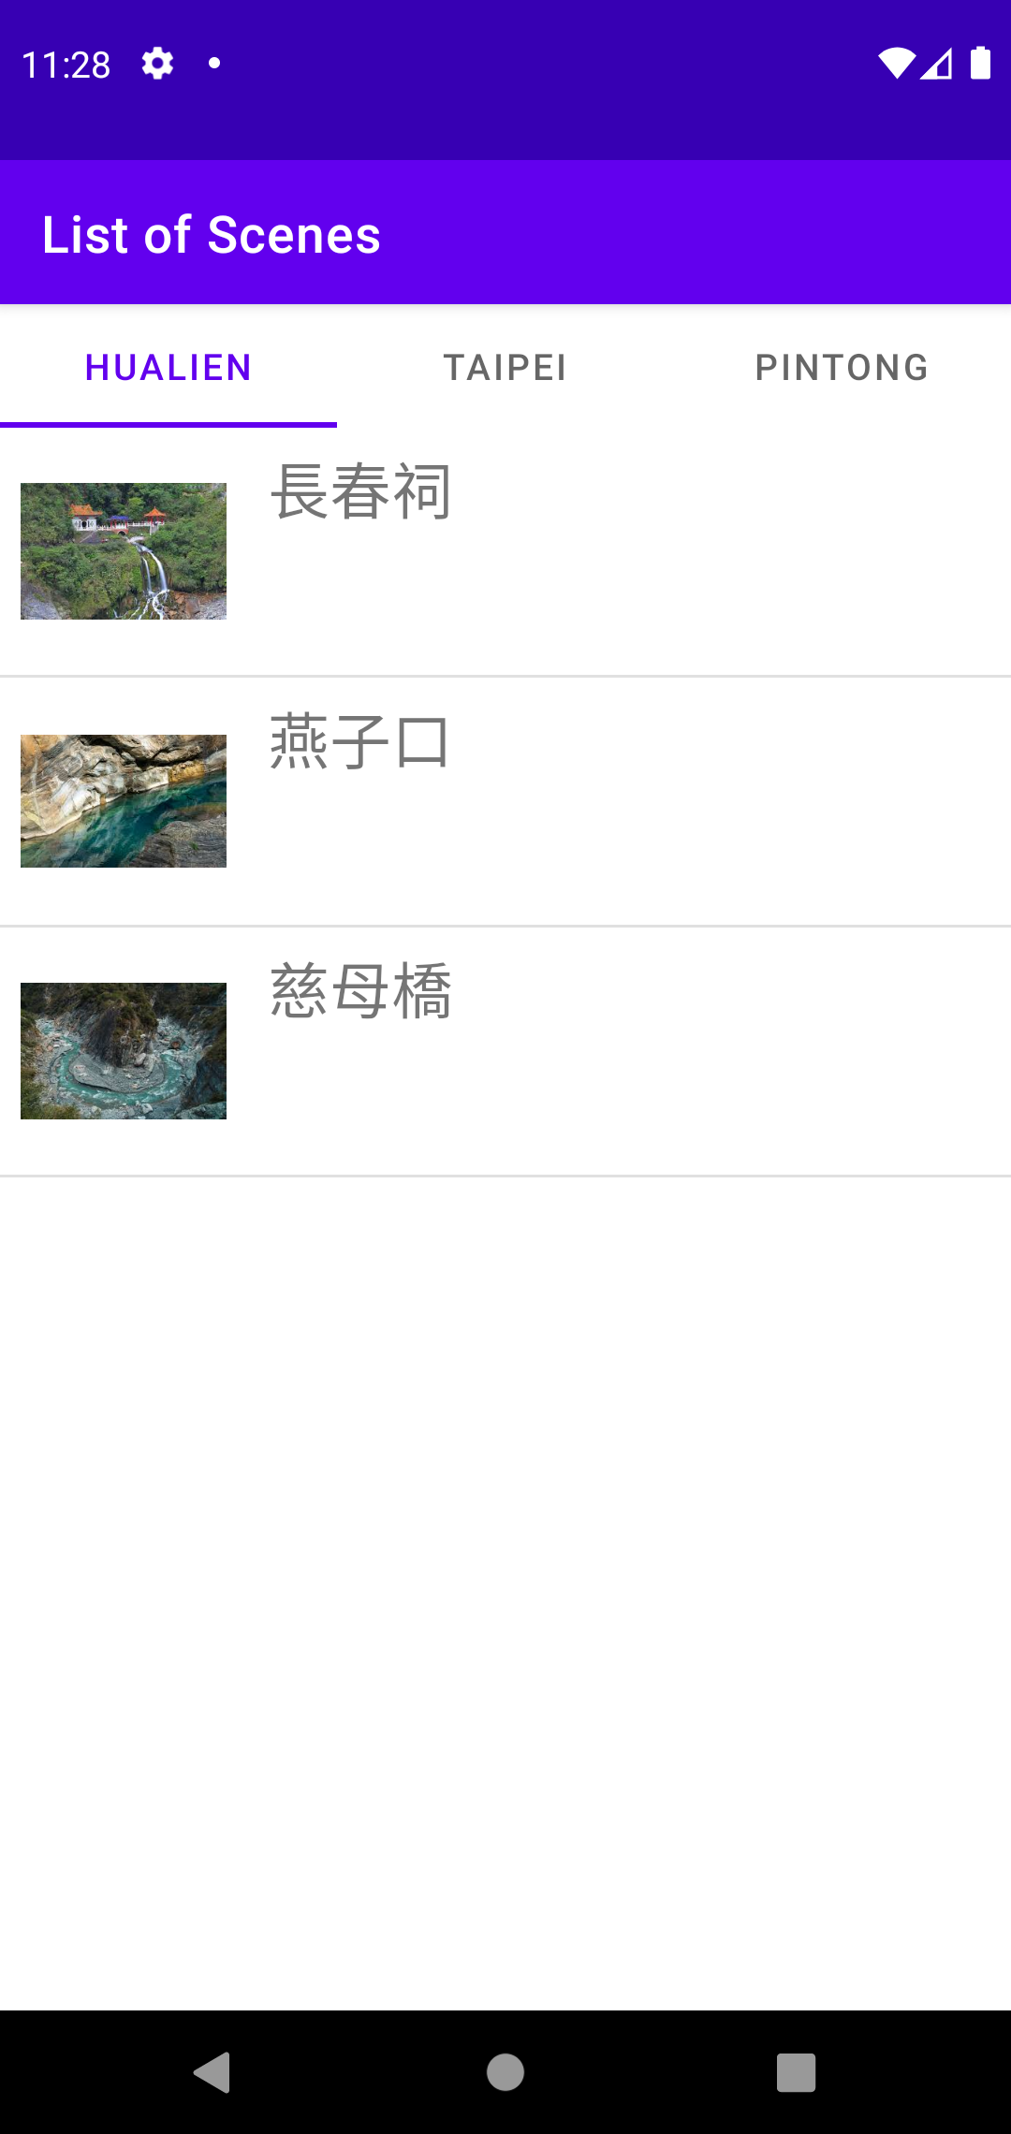
Swipe-able Fragment
Each page is controlled by a fragment which includes
a recylerview in this example
A TabLayout is included

Slide 58
Implement FragmentStateAdapter
class FragmentAdapter(fragmentActivity:FragmentActivity, val cityList: List<String>): FragmentStateAdapter(fragmentActivity) { override fun createFragment(position: Int): PageFragment { //create a new fragment with a passed argument of the city name return PageFragment.newInstance(cityList[position]) } override fun getItemCount(): Int { return cityList.size } }

Slide 59
Configure the ViewPager
binding.viewPager.adapter = FragmentAdapter(requireActivity(), viewModel.cityList) //configure the tablayout
TabLayoutMediator(binding.tabs, binding.viewPager) { tab, position -> tab.text = viewModel.cityList[position] }.attach()

Slide 60
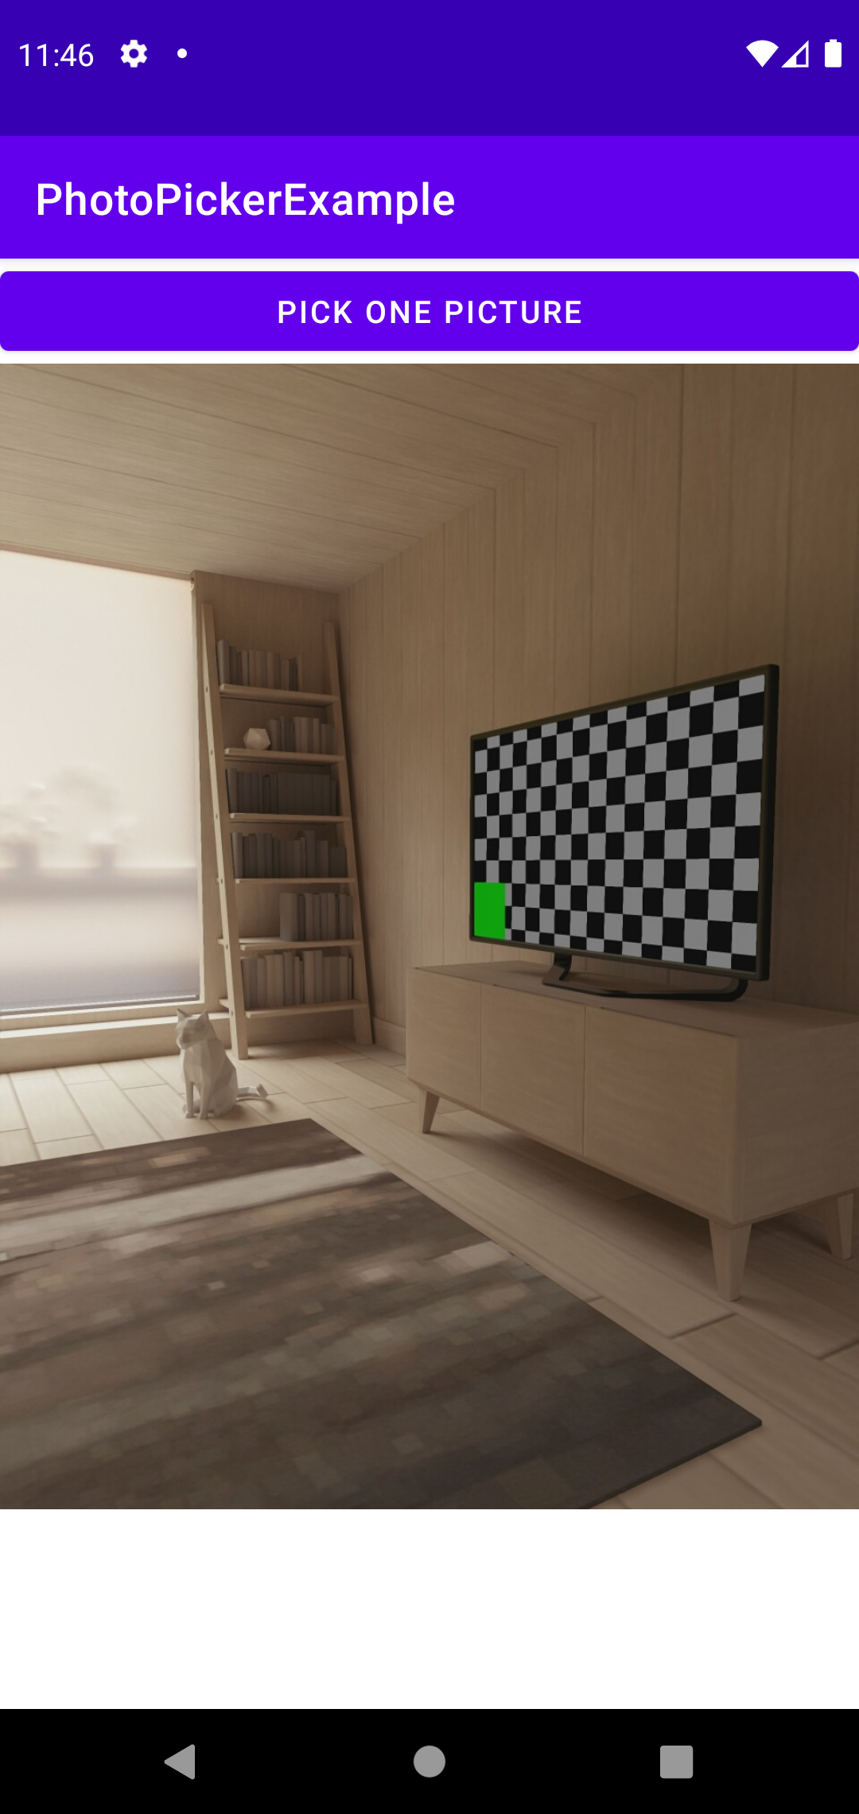
Picture Pickup
Trigger the picture pickup event
binding.pickButton.setOnClickListener { val intent = Intent(Intent.ACTION_OPEN_DOCUMENT) intent.addCategory(Intent.CATEGORY_OPENABLE) intent.type = "image/*" startActivityForResult(intent, PICKUPIMAGE) }

Slide 61
Picture Pickup
Display the selected picture
override fun onActivityResult(requestCode: Int, resultCode: Int, data: Intent?) { super.onActivityResult(requestCode, resultCode, data) when (requestCode) { PICKUPIMAGE -> { if (resultCode == Activity.RESULT_OK && data != null) { data.data?.let { Glide.with(this).load(it).into(binding.imageView) } } } } }

Slide 62
Use Glide to Download Images
Third-party library to download, buffer, decode, and cache images from the Internet
(Module) build.gradle
Usage
implementation "com.github.bumptech.glide:glide:4.8.0"
Glide.with(imgView.context) .load(imgUri) //any remote/local file, or resource id .into(imgView)

Slide 63
Glide’s Setting
Provide the pre-loading image and the error image
.apply(RequestOptions().placeholder(R.drawable.loading_image) .error(R.drawable.broken_image))
More options setting: http://bumptech.github.io/glide/doc/migrating.html#requestoptions

